Slide 1
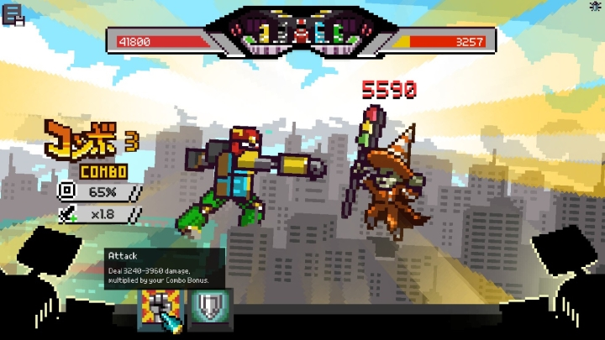
Game Mechanics
Player Movement: Player will be able to move on world map using A,S,D,W keys on keyboard.
Very little physics require .ie hit detection when colliding with cities icon on map.
-When player enter city, no player character shown on screen only building with clickable options.
Combat: -It purely turned based game with no movement and
only click buttons for player actions i.e. attack , defend etc.
-Player and enemy will have health bars to show damage dealt and taken.
-Player will have options to take health potions in combat
to revive its some health .We will be limiting health potions capacity
as to avoid player using lots of them and never die(i.e. cheating).
-Damage dealt will pop in text box above player or enemy
to make it enjoyable because as player progress in game and
see big damage with new level/upgraded weapons.

Slide 2


Game Mechanics
Player Attributes: they will affect how much damage is dealt i.e.
strength attribute and dexterity will increase chances of
scoring a hit on enemy by 20% (max).
Fight Mechanics: Player and enemy will start with lower chance
of scoring hit on each other ie.LvL1 range 40-60% to hit and
LvL2 50-70% . Just because we are using probability mechanics
to decide whether its a hit or not, we will put automatic
hit function when player or enemy have got 3-4 misses in a row
to keep game enjoyable as you don't want 10 misses in a row
its just unfair and boring.

